Slide 1
I-35 Traffic Jam Analysis in Austin, TX
Mostafizur Rahman Shawon
L20570457
Minhajul Abedin Tajik
L2052331
Tushon Dey Babu
L20585317

Slide 2
Background
I-35, a key component of the original Interstate Highway System constructed in 1950, serves as a vital transportation hub in Texas, connecting Austin, Central Texas, and beyond.
I-35's Austin-area section witnesses a substantial daily traffic volume of nearly 200,000 vehicle trips, with 85% of these trips being local to the region .
The research aims to address uncover I-35 congestion patterns, analyze contributing factors , propose solutions.

Slide 3
Purpose of the study
Congestion analysis on I-35 depending on AADT.
Comparison between design speed and actual vehicle speed.
Variation in AADT during 2003-2022.
Total numbers of crash in I-35 from 2018 to 2022.
Finding the potential reasons of congestion.

Slide 4
Workflow
AADT for Texas
City Boundary of Texas
AADT for Austin City
Roadway network of Texas
Clip Data for Austin roadways
Spatial join -AADT & city boundary
Top congested roadways in Texas
Clip congested road for Austin city boundary

Slide 5
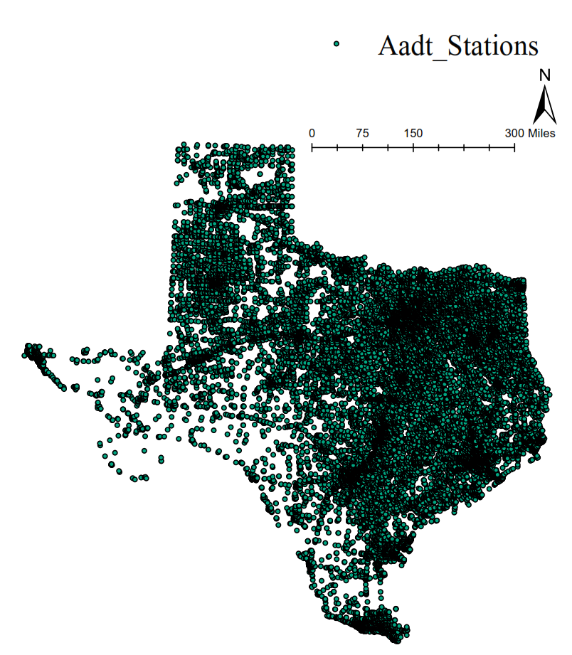

City name
County name
Road name
AADT count from 2003 to 2022

Slide 6
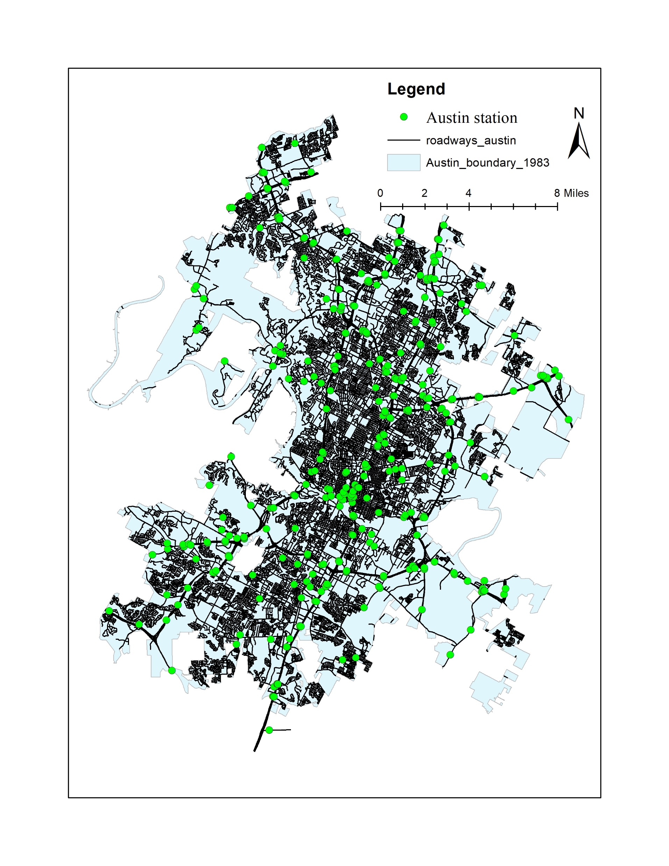
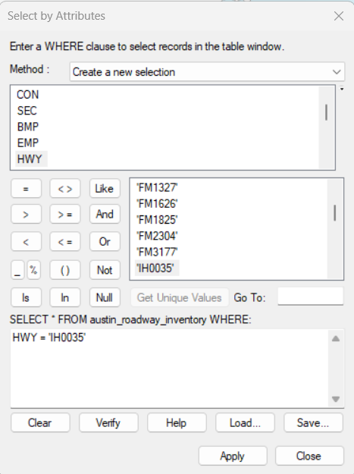

Slide 7
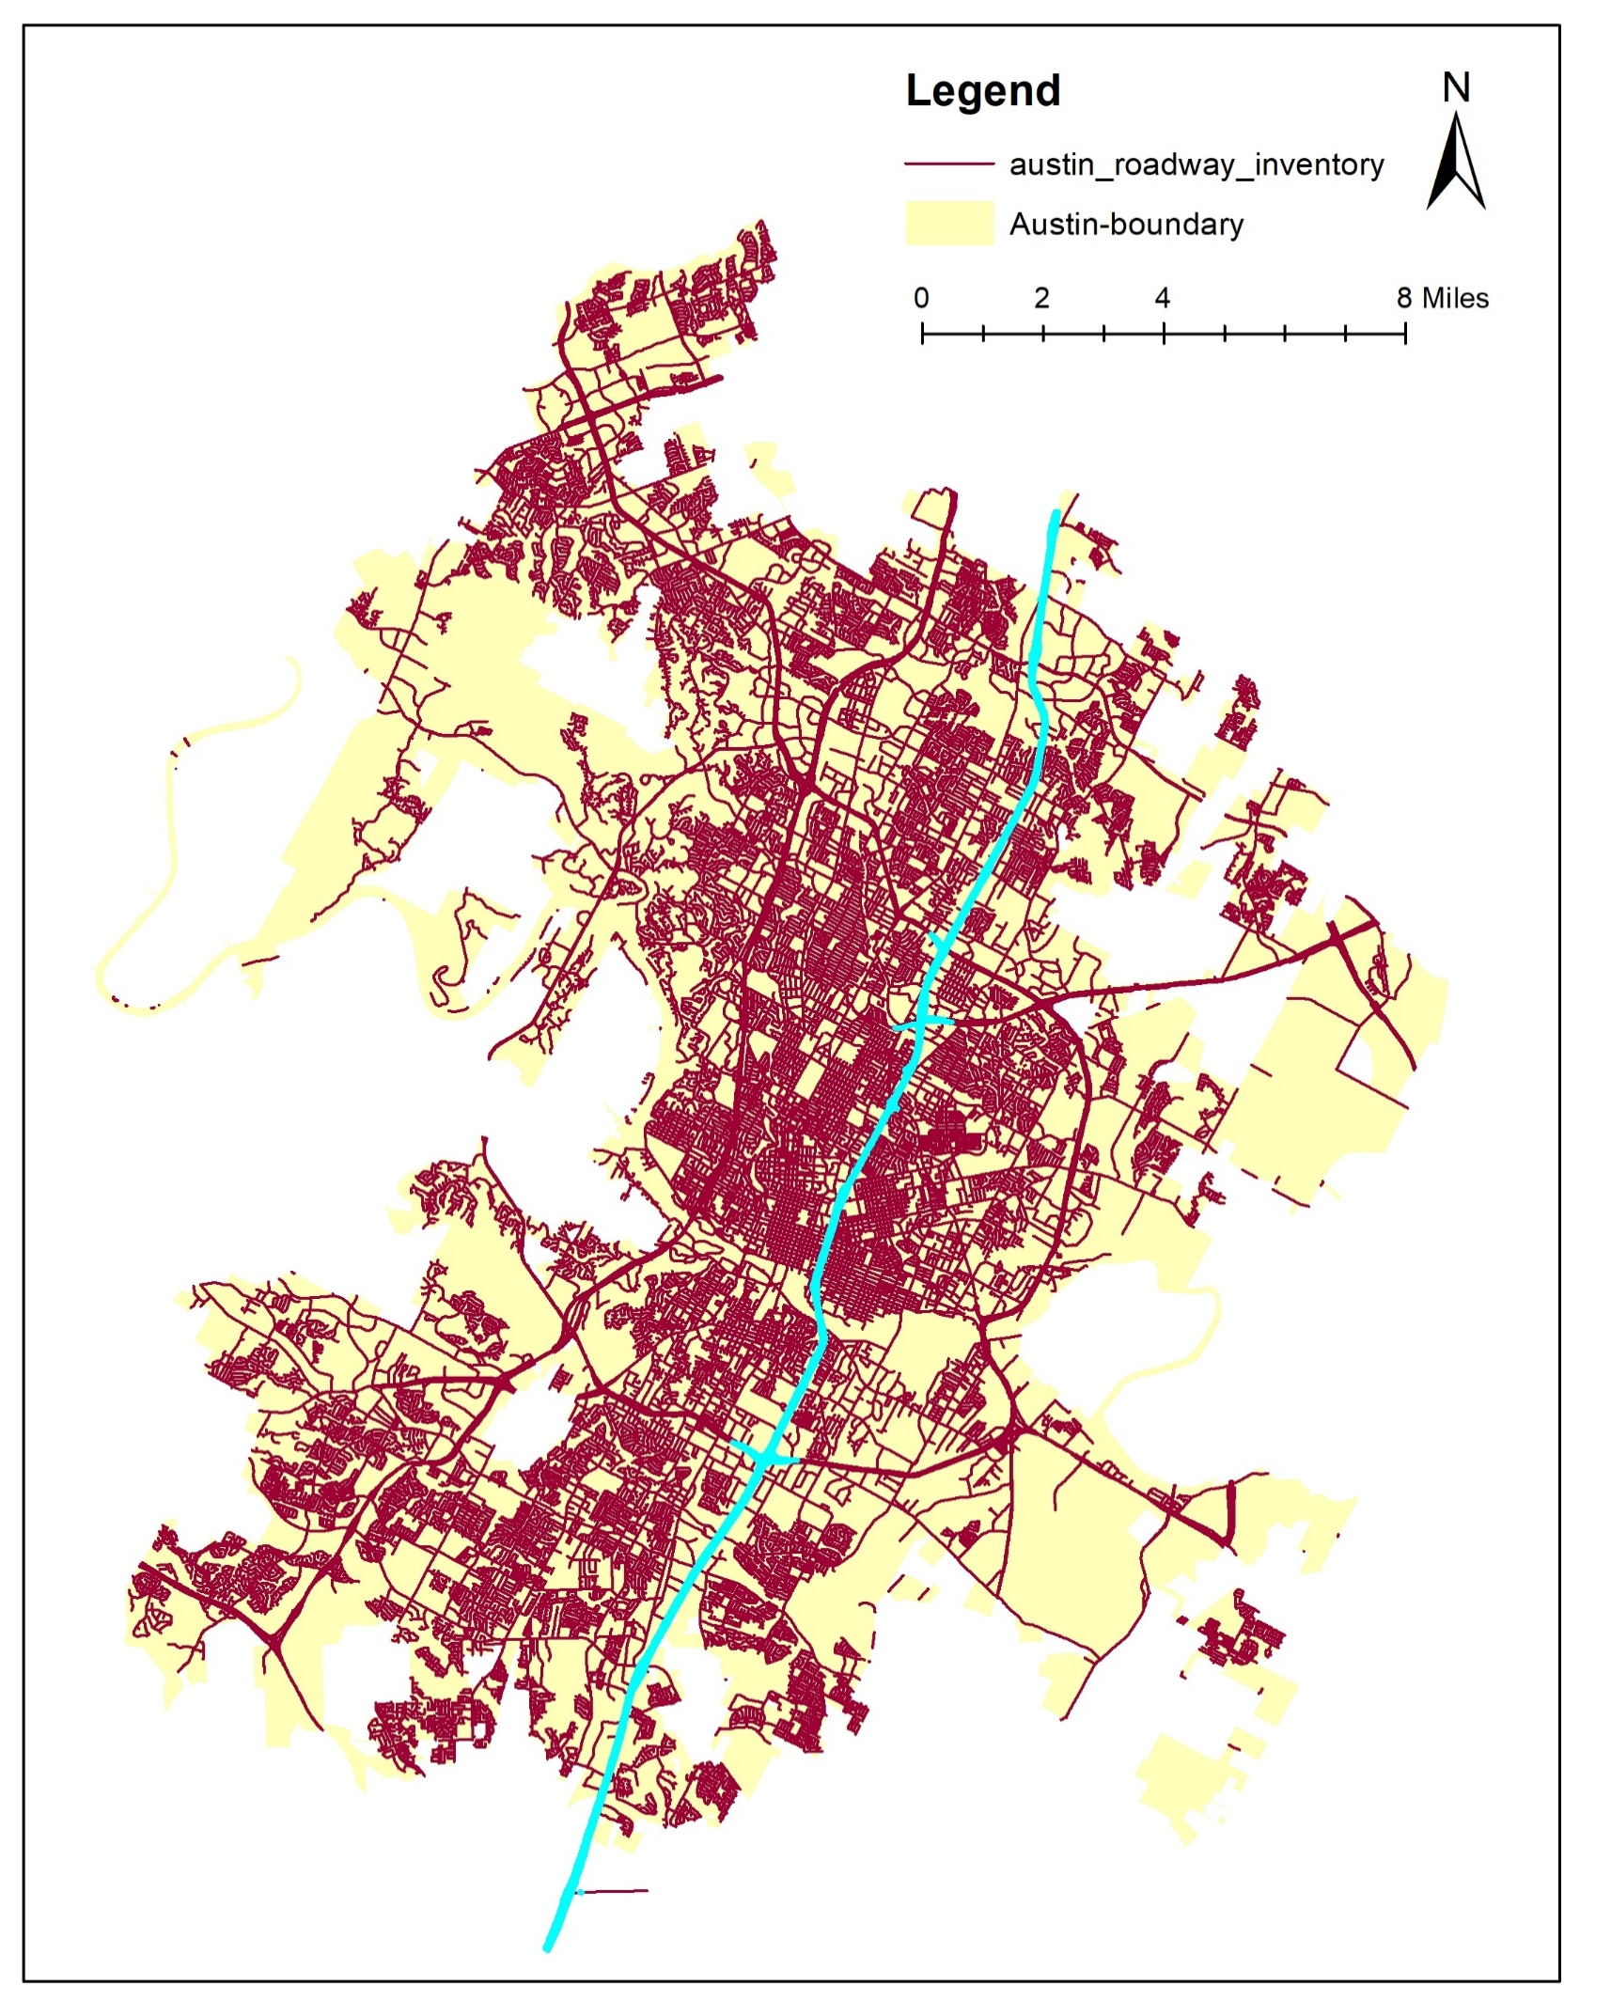
I-35 selection
Total length of i-35 through Austin city.
To calculate traffic volume and capacity for a specific length of a highway

Slide 8
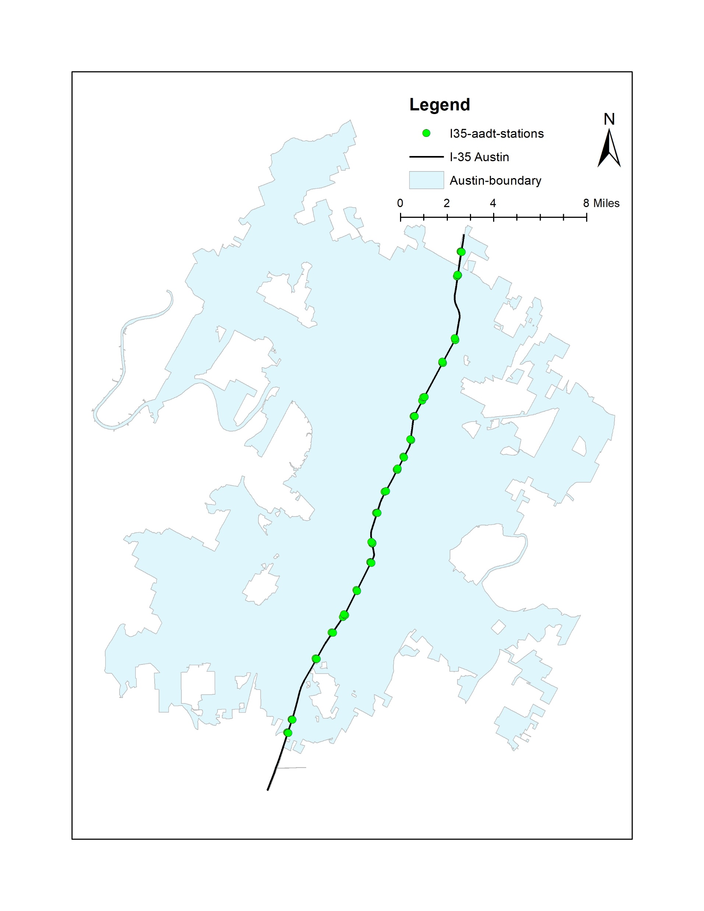
Clipping data from all over Austin to specific i-35 roadways.
AADT data for all 54 stations.
Traffic flow over the year from 2003 to 2022
Total vehicle counts with respect to speed limit.
To determine peak-flow.

Slide 9
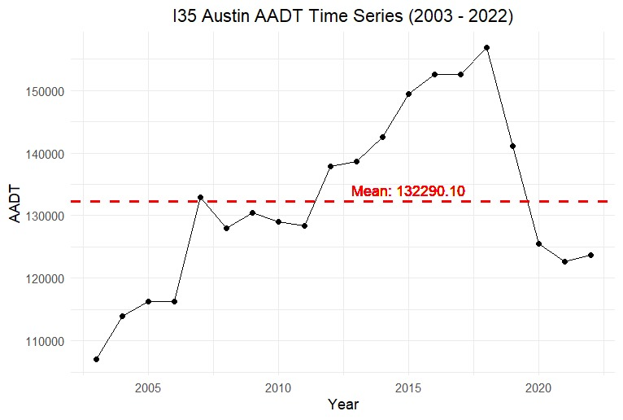
Variation in AADT

Slide 10
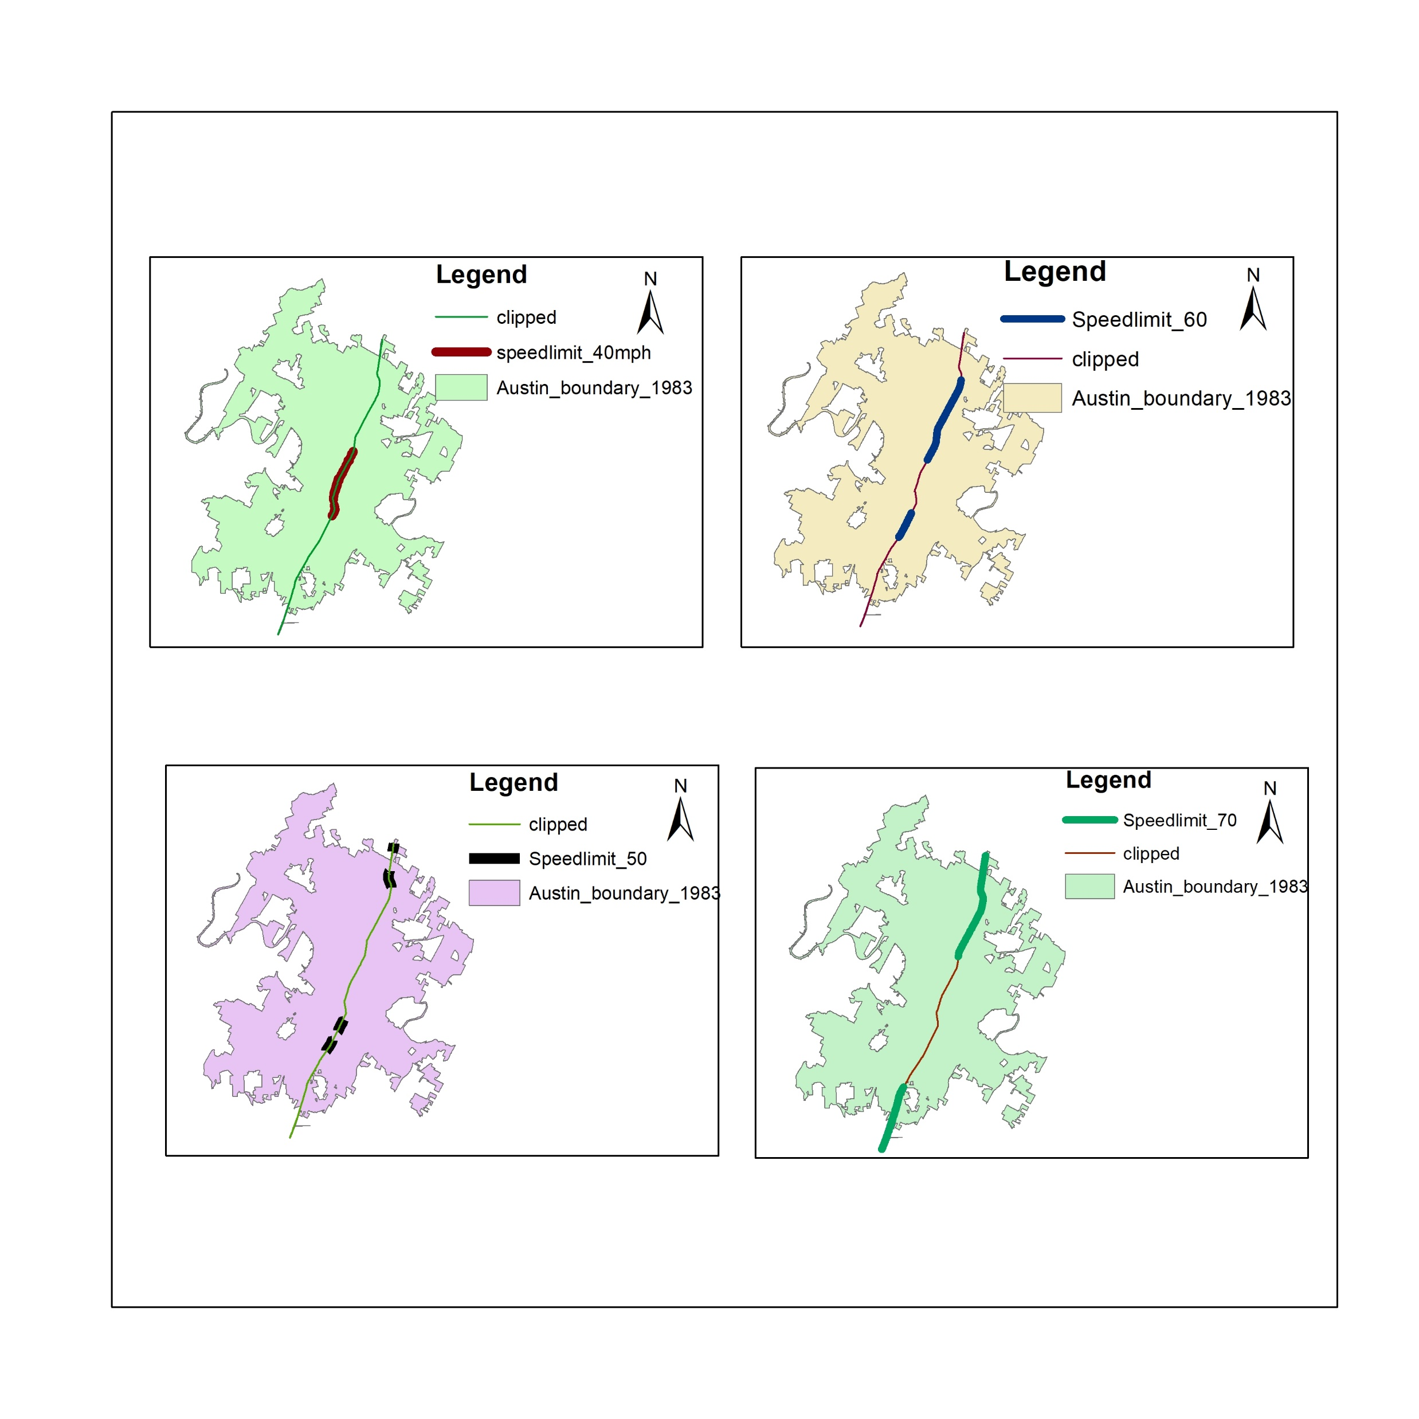
Speed limit of I-35

Slide 11
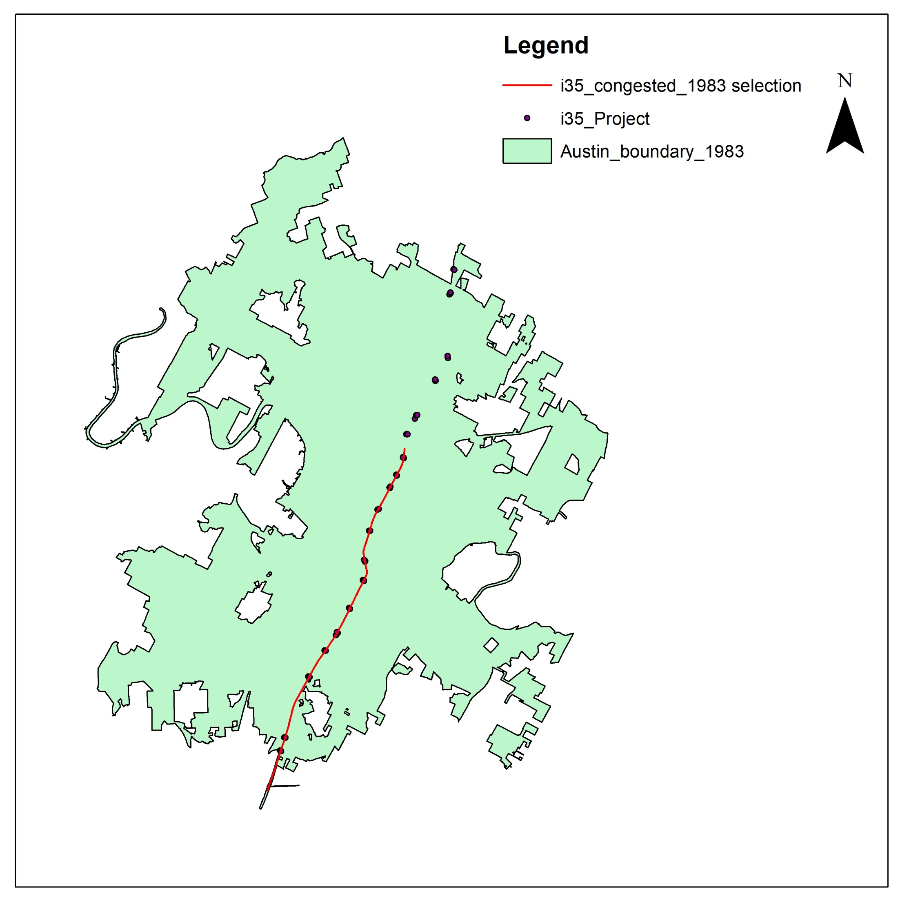
Congestion depending on peak flow.
Total delay time
Total cost delay .
Total delay mile.

Slide 12
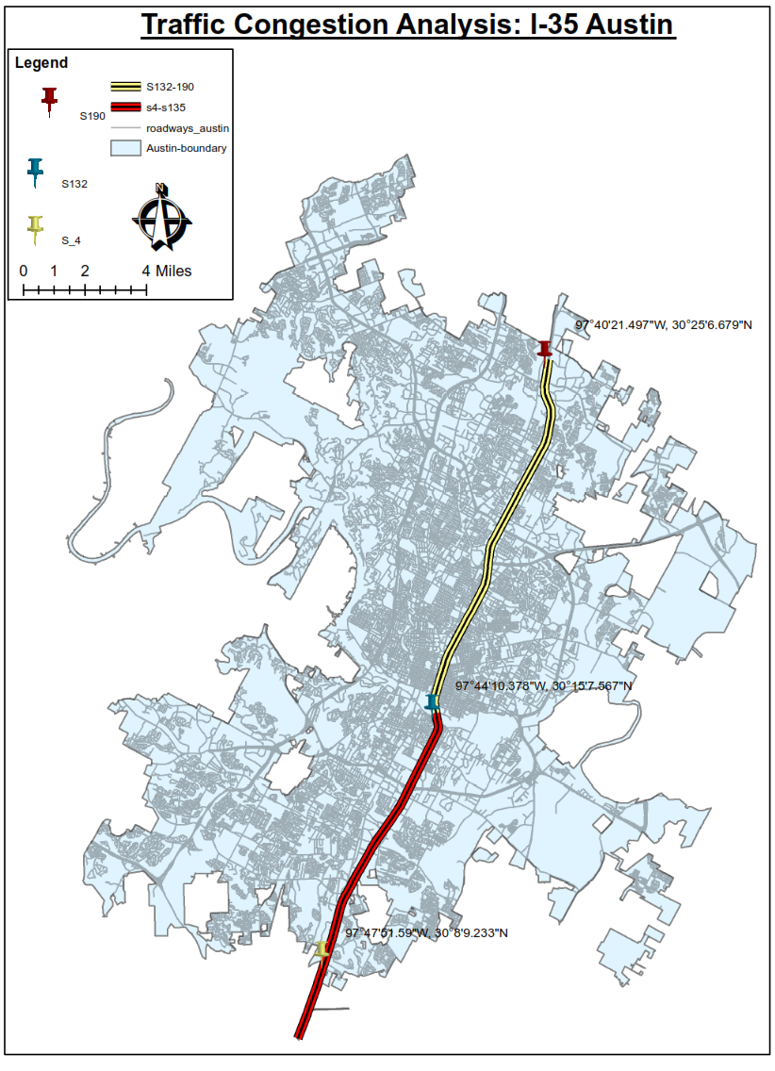
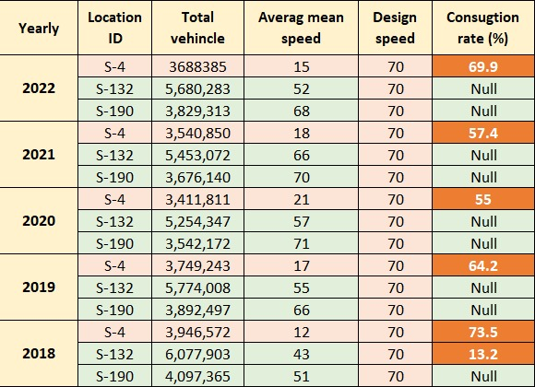
Traffic congestion

Slide 13
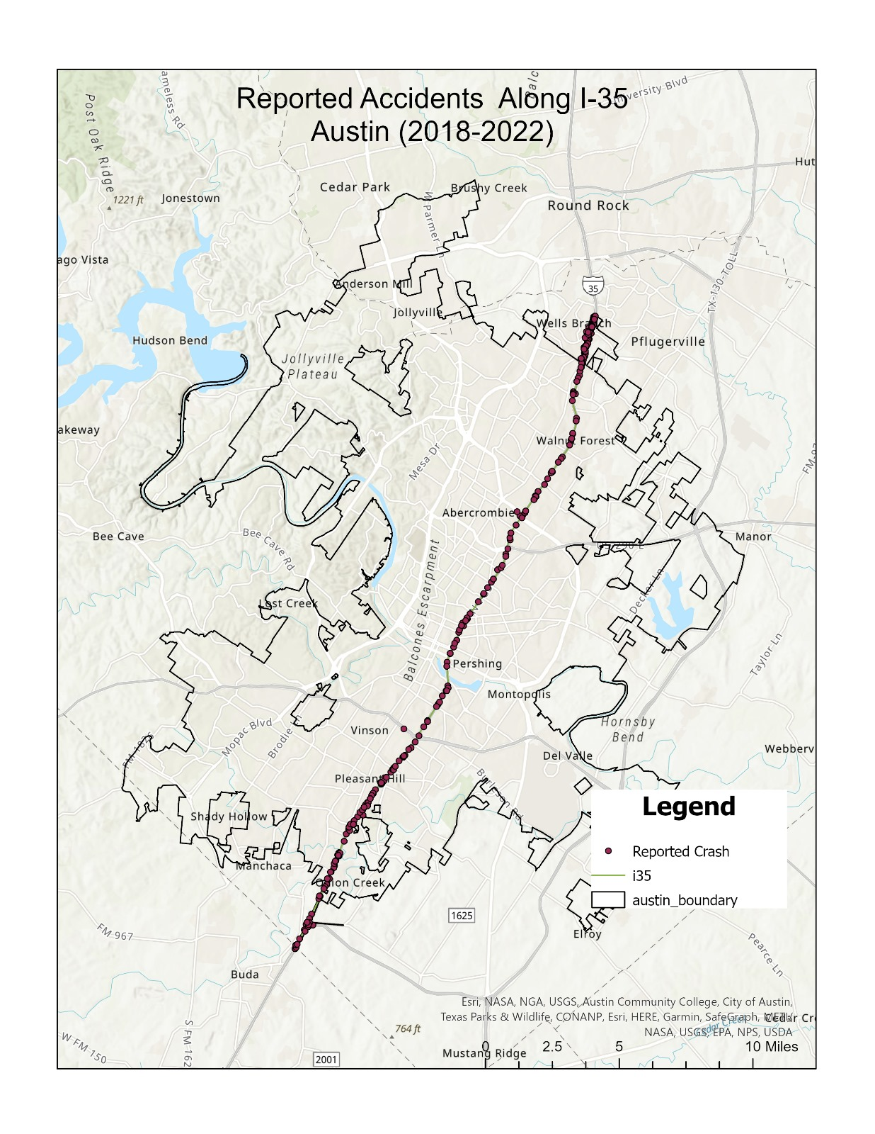
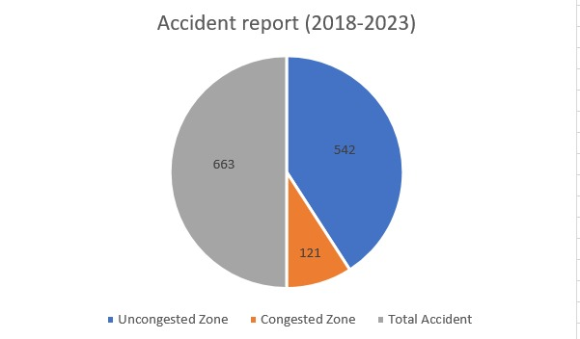
Total accidents= 663
Fatality= 4

Slide 14
Reason of traffic congestion
High traffic volume
Rapid urbanization and increasing number of vehicles
The design and capacity of the road infrastructure, including the number of lanes, interchanges, and exit ramps, play a significant role in traffic flow
Construction work along the way
Accidents on a roadway
Peak time congestion
Weather

Slide 15
Proposed solution
Texas Department of Transportation (TxDOT) is currently working on a project to expand I-35 in Austin. The project is expected to begin in mid-2024 and run until 2033.
Increase the capacity of I-35 by adding additional lanes or by extending the highway.
Improve public transportation options in Austin.
Implement congestion pricing to reduce the number of vehicles on the road.
Encourage people to use arterial road in peak time rather than using I-35.

Slide 16
References
https://gis-txdot.opendata.arcgis.com/datasets/txdot-city-boundaries/explore
https://gis-txdot.opendata.arcgis.com/datasets/TXDOT::txdot-aadt-annuals/explore
https://gis-txdot.opendata.arcgis.com/datasets/TXDOT::txdot-top-100-congested-roadways/explore.
https://txdot.public.ms2soft.com/tcds/tsearch.asp?loc=Txdot&mod=TCDS
https://data.austintexas.gov/stories/s/Austin-Travis-County-Traffic-Report-Page/9qfg-4swh/

